Slide 1
presents:
Navigating the Employee Retention Credit
and Second Look Opportunities for the Hospitality Industry

Slide 2
Introducing
Adam Fisher, Esq.
General Counsel
today’s emcee
Tricera Capital, 2021 – 2022
McDermott Will & Emery, 2017 – 2021
Greenberg Traurig, 2015 – 2017
Bilzen Sumberg, 2014 – 2015
EZ-ERC’s team of Managing Directors bring 50+ years of combined Tax Advisory and Big Consulting Experience
Kyle Morabito, Esq.
CLO & Managing Director
Victoria Beck, Esq.
Compliance Counsel
JJ Budzik, JD
Managing Director
Tenures at DLA Piper, McDermott Will & Emery, and Bilzin Sumberg
Tenures at Hill Wallack LLP and Parker McCay P.A.
Tenures at Alvarez & Marsal, Arthur Andersen, and Deloitte

Slide 3
THIS IS
What you’ll learn
1
Employee Retention Credit (ERC) 101
2
Debunking Misconceptionss About the ERC
3
How to Qualify and Apply
4
What to Look Out For In an ERC Advisor
ez-erc.com
Notes:
Adam

Slide 4
ERC 101
ez-erc.com

Slide 5
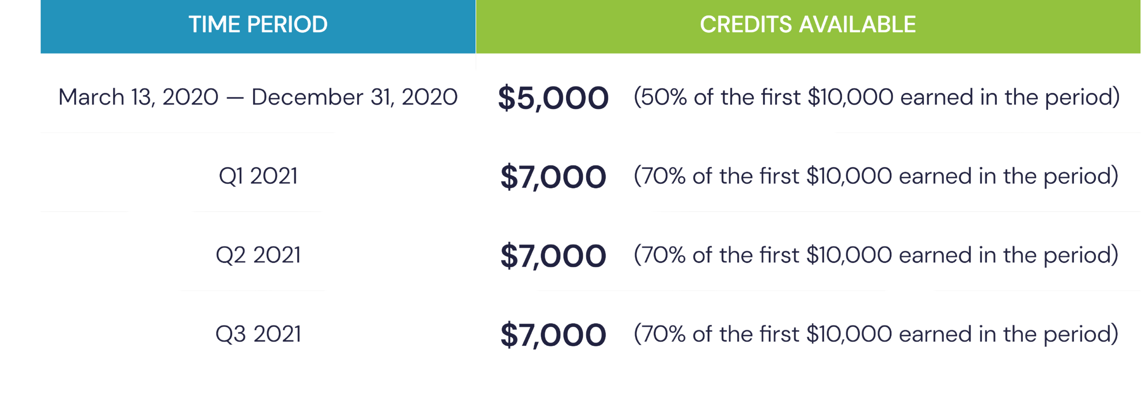
How much can a business claim?
The maximum amount an employer can receive for any W2 employee is $26,000.
Funds available per W2 employee are as follows:
Notes:
Jeff

Slide 6
ERC Timeline
MARCH 2020
DECEMBER 2020
MARCH 2021
APRIL 15, 2024
APRIL 15, 2025
ERC created as part of the CARES Act
Extended and expanded through the Consolidated Appropriations Act of 2021
Further extended through the American Rescue Plan
Filing deadline for all quarters in 2020
Filing deadline for all quarters in 2021
ez-erc.com
Notes:
Jeff – highlight deadlines

Slide 7
CARES Act
Paycheck Protection Program (PPP)
Employee Retention Credit (ERC)
The first COVID-19 relief taken by most businesses
Forgivable loan
Only to be used for qualified expenses – payroll, rent, etc.
Unlike PPP, no allocation of funds by the Small Business Administration – ERC is from U.S. Treasury
Unlike PPP, ERC is a cash refund that can be used in any manner
Credit earned on wages not utilized for PPP forgiveness (i.e., no double dipping)
Notes:
Jeff

Slide 8
Debunking Misconceptions About the ERC
ez-erc.com

Slide 9
misconception:
Many businesses have dismissed the possibility of ERC eligibility due to stable or increased revenue over the tested eligibility period (i.e. 2020-2021)
Businesses that didn't experience revenue declines aren't eligible
There are two clear ways to know if you qualify for the ERC:
the Significant Decline in Gross Receipts test (financial statement test); or
the full or partial suspension of operations test (governmental order test).
You do not need to satisfy both.
The suspension of operations test takes specialized knowledge and is difficult to assess without the support of a qualified advisor.
ez-erc.com
Notes:
Tori

Slide 10
Your business can qualify for the 2020 credit if you had 100 or fewer average monthly full-time W-2 employees in 2019 and the 2021 credit based on an increased threshold of 500 employees in 2019.
Misconception
Our business is too large to qualify
Not all employees count towards the limitation - only full-time W-2 employees from 2019 count.
Full-time employees are those W-2 employees who work at least
130 hours per month.
Aggregation rules must be considered to accurately determine which employees must be counted.
Notes:
Jeff

Slide 11
misconception:
I received a PPP loan, so I don't qualify for the ERC
Even if you took a PPP loan, that does not automatically disqualify you from receiving the ERC.
There are multiple ways, supported by examples provided by the IRS, to maximize the interaction of ERC and PPP.
.
ez-erc.com
Notes:
Jeff

Slide 12
How to Qualify
& Apply
ez-erc.com

Slide 13
Eligibility
Notes:
Kyle

Slide 14
Four-Pronged Approach:
How EZ-ERC approaches the full or partial suspension analysis for hospitality businesses
1
Can your operations be broken down into “portions” or “segments”?
Dine-in or takeout
Event space, food and beverage, or room revenue
What COVID-19 governmental orders imposing mandated restrictions affected your organization during the pandemic?
Social distancing & capacity restrictions;
Increased sanitization & disinfection;
COVID-related absences & quarantine.
What changes or modifications did you make to your business operations to comply with these governmental orders?
What was the impact? Was there a “more than nominal” (>10%) impact on the operations of the segment/portion?
2
3
4
Notes:
Tori
Just because overall revenue did not decrease, that does not mean that parts of your business did not suffer from pandemic-related restrictions.
Examples of how the suspension of operations test can be applied to restaurants like yours include:
Closure of in-person dining - in this case, if your dining rooms were closed, you saw a suspension of part of your business operations even if your revenue didn't decline due to increased take-out orders.
Social distancing - led to decreased number of tables being allowed within your dining rooms. Many locations had to decrease the number of tables to keep them the mandated 6ft apart.
Capacity restrictions - like social distancing, these mandates allowed fewer guests within your restaurants.
Heightened cleaning requirements meant flipping tables from one party to the next took longer than normal.

Slide 15
Closure of In-Person Dining
Social Distancing
Examples of
Suspension of Operations
Capacity Restrictions
Heightened Sanitization Requirements
Closure of Amenities
Gathering Restrictions
Notes:
Tori

Slide 16
Aggregation Implications
Full-Time Employee Count
Gross Receipts
Full or Partial Suspension of Operations
Aggregation
Credit per Employee
ez-erc.com
Notes:
Jeff -

Slide 17
How a Second Look Can Increase your
ERC Claim
ez-erc.com

Slide 18
There’s no harm in getting a second look if you’re not confident that you’ve received your full credit.
A second look can lead to:
Refiling previously filed quarters to receive full credit.
Filing for quarters you previously missed.
ez-erc.com
Notes:
Kyle

Slide 19
If you've already filed for an ERC claim, but did any of the following, you should consider a second look:
"Blacked out" your entire PPP Covered Period from ERC eligibility
Did not fully evaluate partial suspension through the end of local social distancing orders
Used W2 count instead of FTE count
ez-erc.com
Notes:
Kyle
Refiling is typically based on a poor approach on interacting the PPP with the ERC or erroneously excluding certain purported related parties.
Filing for quarters missed would be due to misapplication of FTE, Aggregation, or Partial Suspension.

Slide 20
Social Distancing Dates to Keep in Mind
California June 15, 2021
Texas March 31, 2021*
Florida September 25, 2020 or May 3, 2021
New York June 24, 2021
Pennsylvania May 31, 2021 or June 15, 2021
Illinois June 11, 2021*
Ohio June 18, 2021*
Georgia May 1, 2021*
North Carolina March 23, 2021 or May 14, 2021*
Michigan June 22, 2021
* Counties and/or cities may have had more restrictive level orders
General Rule of Thumb
Blue States (and large cities): April 2021 – June 2021
Red States: September 2020 – March 2021
Notes:
Kyle

Slide 21
What To Look
For In An
ERC Advisor
ez-erc.com

Slide 22
What differentiates EZ-ERC from its competitors?
﻿﻿﻿Tax Guidance: Kenneth Dettman (former partner at Alvarez & Marsal and Co-Head of their ERC Taskforce) signs every ERC filing as paid preparer; thereby taking responsibility for our clients' ERC tax positions;
﻿﻿﻿Legal Guidance: We work side-by-side with some of the top law firms in the country specializing in the ERC and even work several lawyers who were integral in writing the ERC legislation;
﻿﻿﻿Legal Opinion: EZ-ERC pays for a tax attorney to prepare a legal analysis and/or opinion, where applicable, substantiating our clients' ERC legal eligibility; thereby taking responsibility for our clients' ERC legal positions;
Tax Insurance: EZ-ERC has relationships with insurance providers that can source tax insurance policies to protect our clients’ ERC claims;
﻿﻿﻿Timing: We can finalize and submit an ERC claim to the IRS within a month from the time a client signs our engagement; and
﻿﻿﻿Price: EZ-ERC generally charges 10-20% of the credit (competitors generally charge 25-30%).
ez-erc.com
Notes:
Kyle

Slide 23
Documentation Required
Ownership and Related Party Information
Full-Time Employee Count (2019)
Gross Receipt Substantiation (2019-2021 Quarterly P&Ls)
Payroll Tax Filings
Payroll and Employer-Paid Health Information
PPP Information
Tax Return Support
Other Wage-Based Tax Credits
ez-erc.com
Notes:
Adam delegate

Slide 24
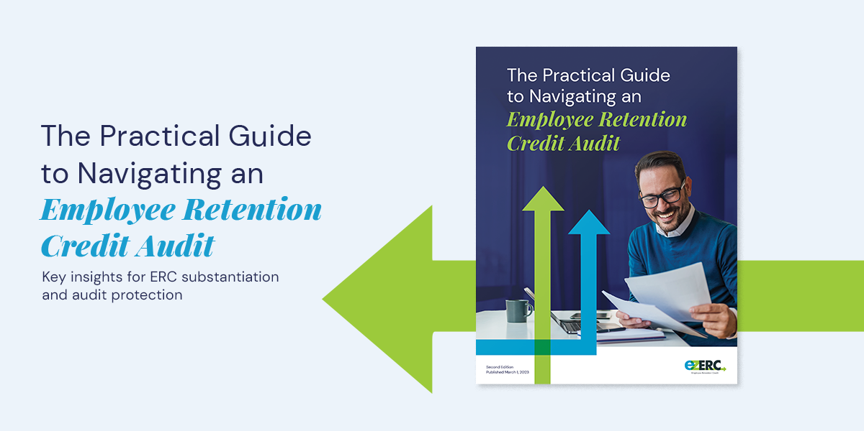
The Unofficial Audit Guide
https://www.ez-erc.com/practical-guide/
Notes:
Adam delegate

Slide 25
Q&A
ez-erc.com

Slide 26
Contacts
Adam Fisher, Esq.
General Counsel
Kyle Morabito, Esq.
Managing Director
Victoria Beck, Esq.
Compliance Counsel
JJ Budzik, JD
Managing Director
adamfischer@ez-erc.com
kyle@ez-erc.com
victoria@ez-erc.com
jeffb@ez-erc.com
ez-erc.com

